Slide 1
Historical Marker
Restoration
Keeping History Alive

Slide 2
Historical Marker
Restoration
Preserving and Protecting Texas Historical Markers and Monuments maintain the importance of keeping our past alive for future generations.
Across the State of Texas, we have many markers that need major restoration.
Working together with various groups in a community can restore these markers to noticeable script.

Slide 3
Historical Marker
Restoration
One might ask, How can we as a community preserve these markers for future generations.
Groups begin by identifying markers in the immediate area that need attention.
Meet with the government agency in the area that has control of the marker and site.
Explain the process for completion of the restoration and timeline.

Slide 4
Historical Marker
Restoration
Most County were given the markers to oversee by the State of Texas Congress
The County is responsible for the maintenance, repair, and management of the markers
The Historical Commission depends on local and state entities to help fund replacement and repairs
Historical Commission is made up of volunteers who are selected to oversee the restoration projects.

Slide 5
Historical Marker
Restoration
There are five types of markers that are the most recognizable
Centennial flat marker
Rectangular Centennial Marker
Texas Centennial Marker
Texas Historical Marker
Texas Historical Cemetery

Slide 6
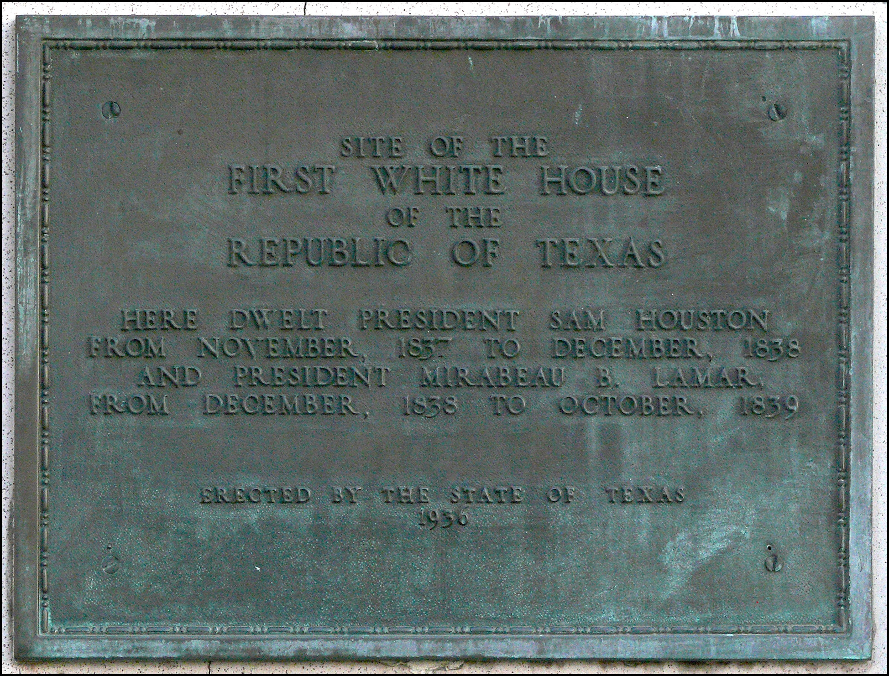
Historical Marker
Restoration
Sterling Building in Downtown Houston

Slide 7
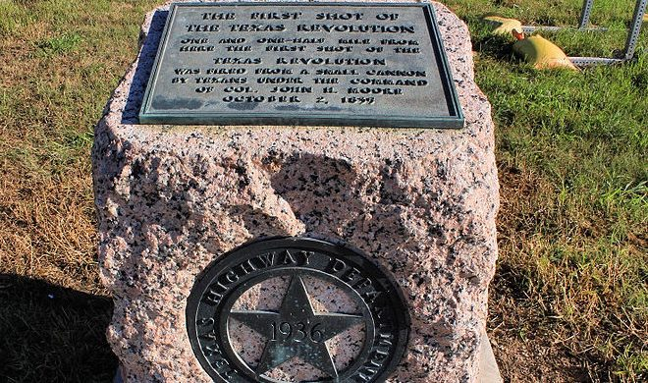
Historical Marker
Restoration

Slide 8
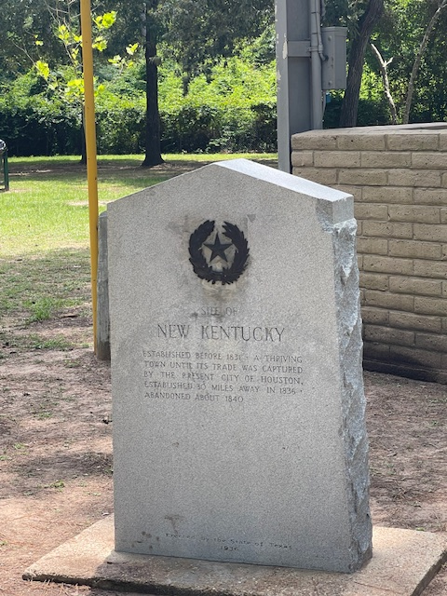
Historical Marker
Restoration

Slide 9
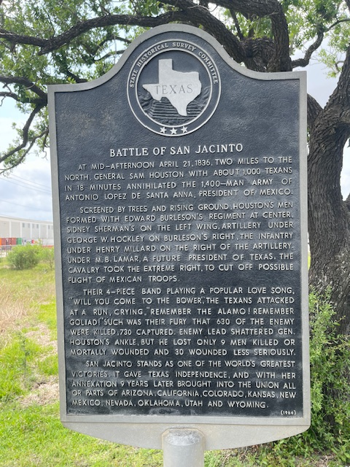
Historical Marker
Restoration

Slide 10
Historical Marker
Restoration
How this all started – several years ago
Vince’s Bridge Marker
Placed by the Daughters of Republic of Texas -San Jacinto Chapter in the early 1900’s
Neither the County or Pasadena wanted to claim the area.
Marker was mowed around and new Texas Flags placed

Slide 11
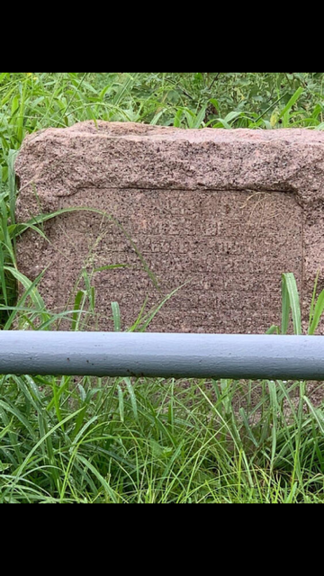
Historical Marker
Restoration

Slide 12
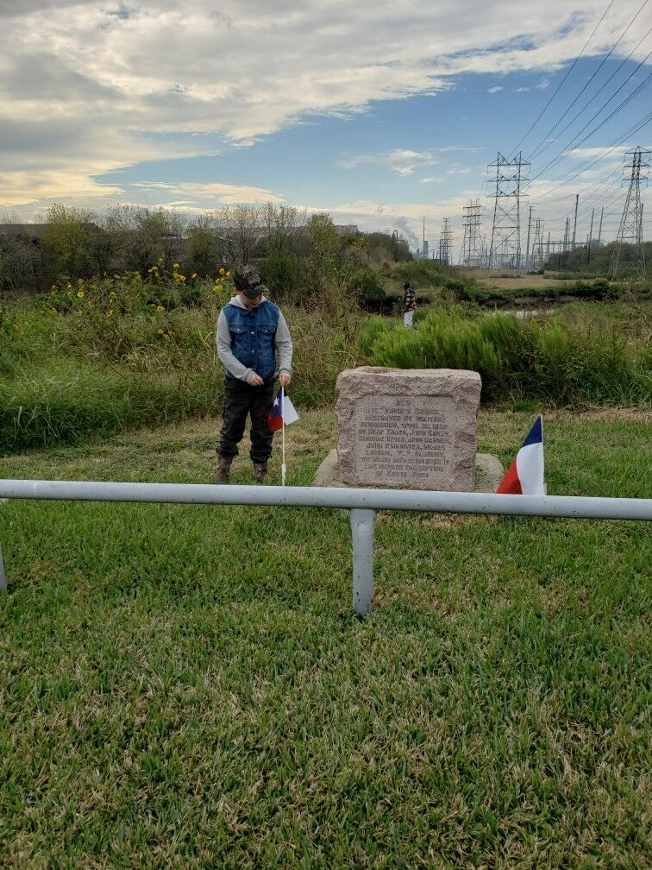
Historical Marker
Restoration

Slide 13
Historical Marker
Restoration
Issac Batterhouse Marker
The Batterson House flooring was used by Sam Houston’s Texian Army to cross Buffalo Bayou
The Batterson house was also used to shelter the sick and injured as was the DeZavalla Home
First marker that the Harris County Historical Commission wanted restored.

Slide 14
Historical Marker
Restoration Materials/Tools
Safety Cones if you are working in high traffic area
Stiff wire brush (stainless steel works best)
Soft bristle scrub brush
Spray bottle or bucket of water
Soap and towels
Can of High Temperature black lacquer spray paint
Painter’s mask

Slide 15
Historical Marker
Restoration
Can of clear lacquer spray paint
Lacquer thinner
80 grit and 120 grit sandpaper
Power sander or hand sanding block
Roll of two-inch painter's masking tape
Roll of one-inch painter’s masking tape
ladder

Slide 16
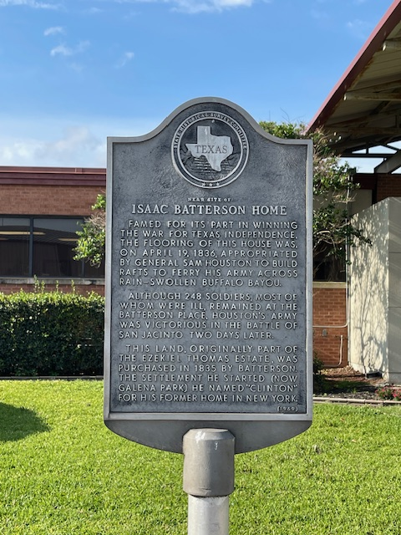
Historical Marker
Restoration

Slide 17
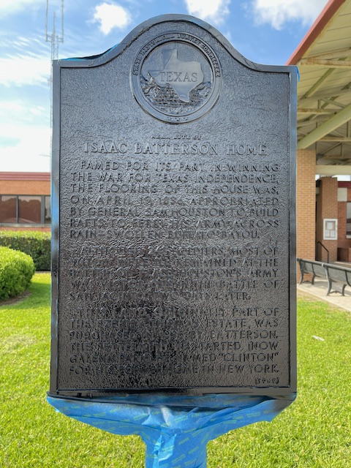
Historical Marker
Restoration

Slide 18
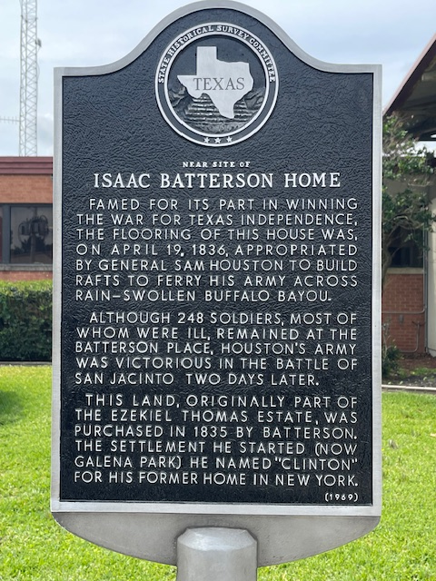
Historical Marker
Restoration

Slide 19
Historical Marker
Restoration
New Kentucky is the historical location of the Abraham Roberts Homesite and Texas Army Route.
Which Way Tree is a spot where Sam Houston and his army were pointed by Abraham Roberts to head southeast, eventually marching to San Jacinto????

Slide 20
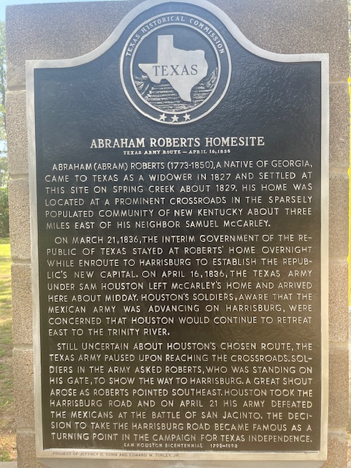
Historical Marker
Restoration

Slide 21
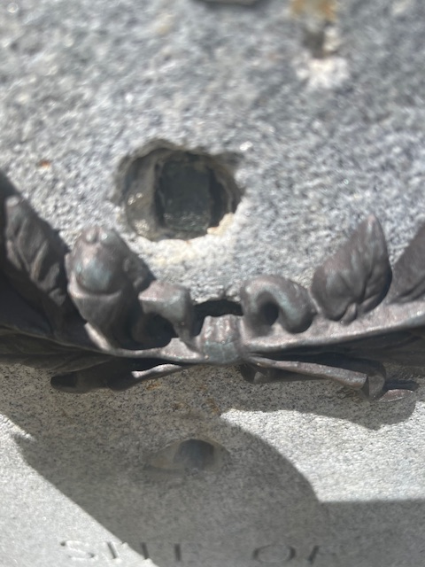
Historical Marker
Restoration

Slide 22
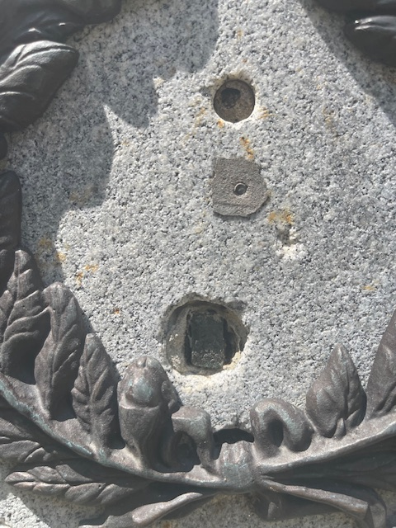
Historical Marker
Restoration

Slide 23
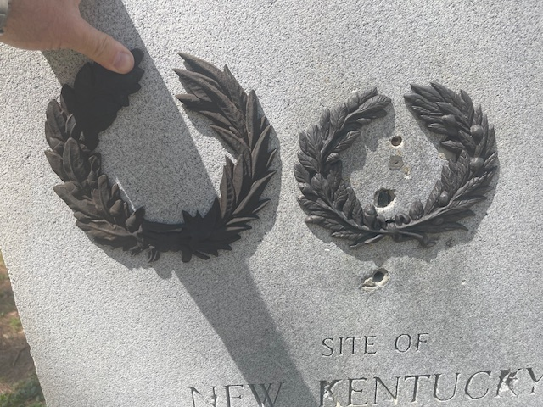
Historical Marker
Restoration

Slide 24
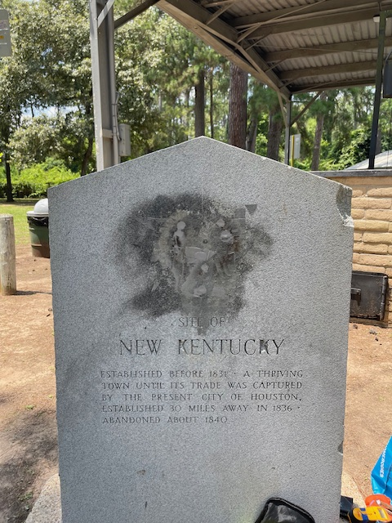
Historical Marker
Restoration

Slide 25
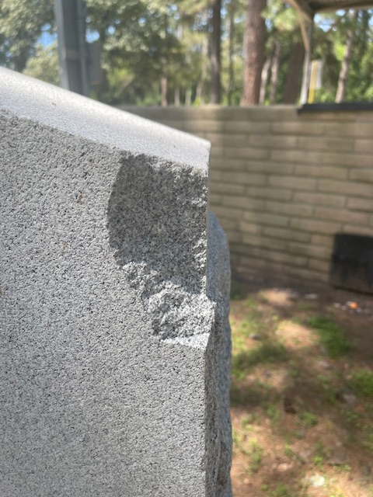
Historical Marker
Restoration

Slide 26
Historical Marker
Restoration

Slide 27
Historical Marker
Restoration
James Morgan, pioneer Texas settler, merchant, land speculator, and commander at Galveston during the Texas Revolution.
James Morgan brought to Texas Emily D. West , the so-called “Yellow Rose of Texas”, and planned a colony of free Blacks from Bermuda.

Slide 28
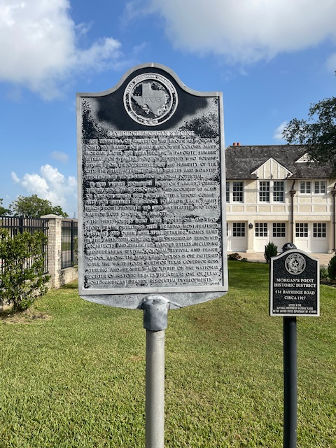
Historical Marker
Restoration

Slide 29
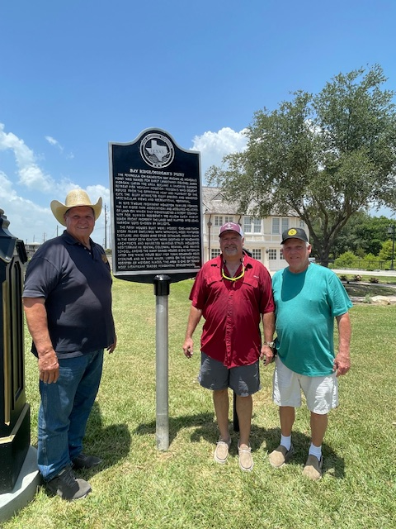
Historical Marker
Restoration

Slide 30
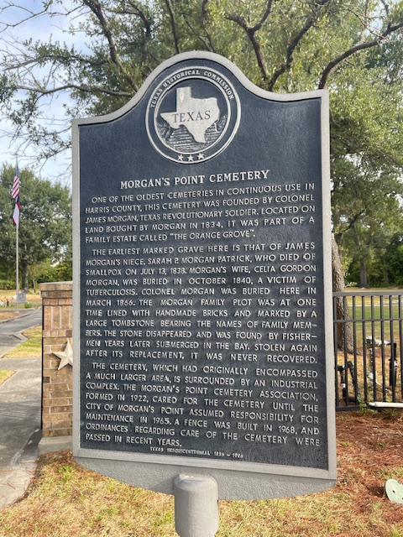
Historical Marker
Restoration

Slide 31
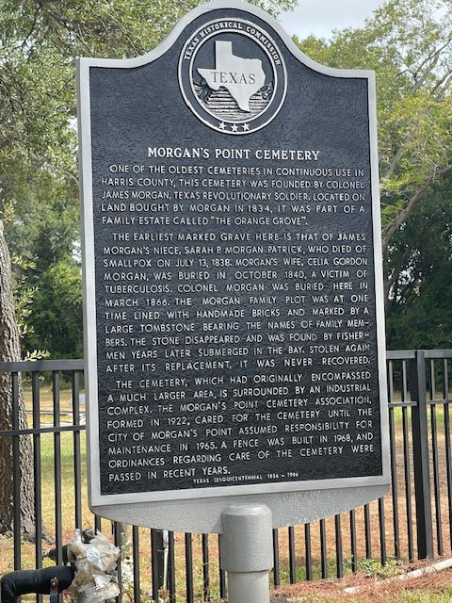
Historical Marker
Restoration

Slide 32
Historical Marker
Restoration
New Washington – Current Day Morgan’s Point
Point where Buffalo Bayou entered San Jacinto Bay
Town laid out by James Morgan
Full of cattle and orange groves
General Santa Anna and his army almost captured David G. Burnet and the ad interim government
Ordered burned by General Santa Anna days before the Battle of San Jacinto

Slide 33
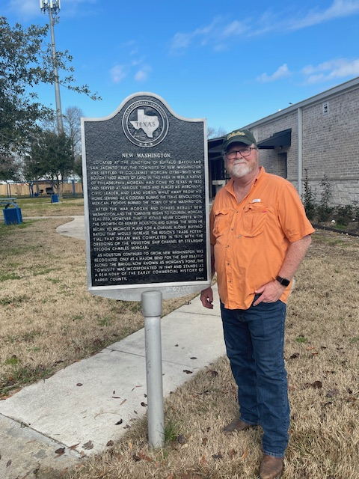
Historical Marker
Restoration

Slide 34
Historical Marker
Restoration
Mirabeau Buonaparte Lamar was an American attorney, politician, poet, and leading political figure during the Texas Republic era.
Jane Wilkinson Long led a long and hard life
Because of the birth of her child on Bolivar Peninsula she was deemed the “Mother of Texas.”
She claimed to have dined with Jean Laffite on Galveston Island.

Slide 35
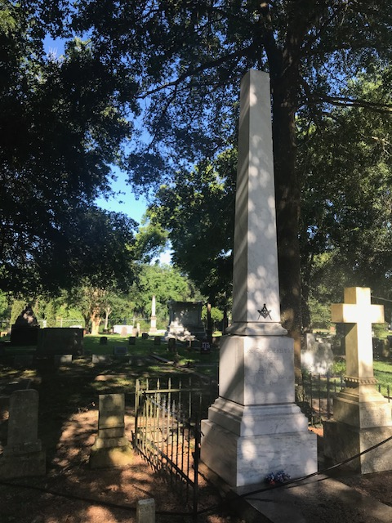
Historical Marker
Restoration

Slide 36
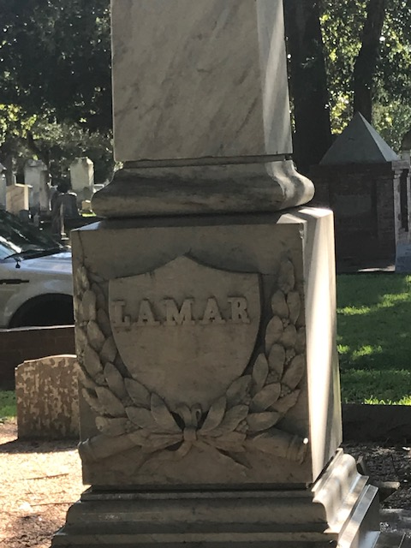
Historical Marker
Restoration

Slide 37
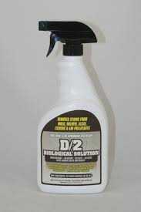
Historical Marker
Restoration

Slide 38
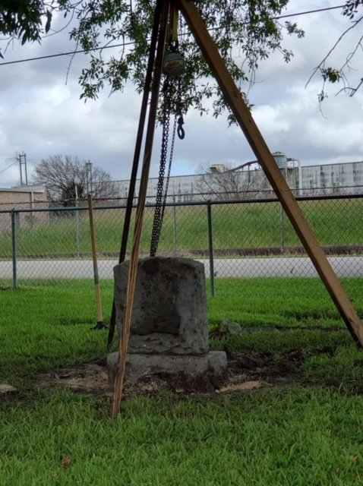
Historical Marker
Restoration

Slide 39
Historical Marker
Restoration
So, you want to clean markers and need to know what to do?

Slide 40
Historical Marker
Restoration
Get permission from the local County Historical Commission
County Historical Commission usually have limited funds
Make sure you have all the right equipment
Is it a metal black and white marker?
Is it a stone marker? D2
Amazon is a good place to start to purchase D2

Slide 41
Historical Marker
Restoration
Last but not least…….
Remember why you are doing the project
Its Texas history….. we do this for them, not us
Preserve, protect, teach
REMEMBER YOUR TEXAS PRIDE!

